Slide 1



Modulo 5
Programación en HTML5 con JavaScript y CSS3

Slide 2
Objetivo Terminal del Modulo 5 (1/2)
Al finalizar este módulo, el participante estará en la capacidad de:
Explica cómo utilizar Visual Studio 2012 para crear y ejecutar una aplicación Web.
Describir las nuevas características de HTML5, y crear estilo HTML5 páginas.
Agregar interactividad a una página de HTML5 con JavaScript.
Crear formularios HTML5 usando diferentes tipos de entrada y validar entradas del usuario mediante atributos HTML5 y código JavaScript.
Enviar y recibir datos de un origen de datos remoto utilizando XMLHTTPRequest objetos y operaciones de AJAX de jQuery.
Páginas de HTML5 estilo utilizando CSS3.
Crear el código JavaScript bien estructurado y fácilmente mantenible.
Utilizar APIs de HTML5 comunes en aplicaciones Web interactivas.
Notes:
20687B
1: Installing and Deploying Windows 8

Slide 3
Objetivo Terminal del Modulo 5 (2/2)
Crear aplicaciones Web que soportan las operaciones fuera de línea.
Crear páginas Web HTML5 que pueden adaptarse a diferentes dispositivos y factores de forma.
Añadir gráficos avanzados para una página HTML5 utilizando elementos de tela y usando y gráficos vectoriales escalables.
Mejorar la experiencia de usuario añadiendo animaciones en una página HTML5.
Usar Web Sockets para enviar y recibir datos entre una aplicación Web y un servidor.
Mejorar la capacidad de respuesta de una aplicación Web que realiza operaciones de larga duración mediante el uso de procesos de trabajo de la Web.
Notes:
20687B
1: Installing and Deploying Windows 8

Slide 4
Contenido de Modulo, por temas
Overview of HTML and CSS
Creating and Styling HTML Pages
Introduction to JavaScript
Creating Forms to Collect and Validate User Input
Communicating with a Remote Server
Styling HTML5 by Using CSS3
Creating Objects and Methods by Using JavaScript
Creating Interactive Pages by Using HTML5 APIs
Notes:
Briefly describe each module and what students will learn. Be careful not to go into too much detail because the course is introduced in detail in Module 1.
Explain how this course will meet students’ expectations by relating the information that is covered in individual modules to their expectations.

Slide 5
Contenido de Modulo, por temas
Adding Offline Support to Web Applications
Implementing an Adaptive User Interface
Creating Advanced Graphics
Animating the User Interface
Implementing Real-time Communication by Using Web Sockets
Performing Background Processing by Using Web Workers
Notes:
Briefly describe each module and what students will learn. Be careful not to go into too much detail because the course is introduced in detail in Module 1.
Explain how this course will meet students’ expectations by relating the information that is covered in individual modules to their expectations.

Slide 6
Creating Interactive Pages by Using HTML5 APIs (Creación de páginas interactivas usando las APIs de HTML5)

Slide 7
Module Overview
Interacting with Files Incorporating Multimedia Reacting to Browser Location and Context Debugging and Profiling a Web Application
Notes:
The nature of the subjects covered in this module provides scope for lengthy discussions. However, limit each lesson to 15 minutes.
The lab consists of exercises covering the File API, audio and video, and the geolocation API. Depending on the time available and the nature of the class, these three exercises can either be performed together at the end of the module, or they can be tackled individually after each lesson.
20480B
8: Creating Interactive Pages by Using HTML5 APIs

Slide 8
Lesson 1: Interacting with Files
HTML5 File Interfaces The FileReader Interface Reading a Text File Reading a Binary File Implementing Drag-and-Drop
Notes:
20480B
8: Creating Interactive Pages by Using HTML5 APIs

Slide 9
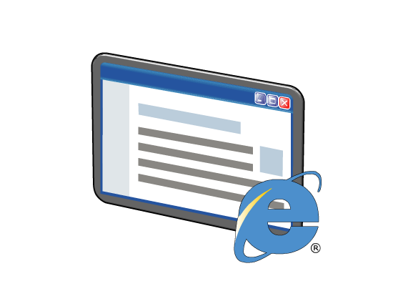

HTML5 File Interfaces
The HTML5 File API enables a web application to access the local file system
There are four key interfaces:
Blob – immutable raw binary data
File - readonly information about a file
FileList – an array of files
FileReader – methods for reading data from a file or blob
Notes:
This module does not cover Blob data or the FileList interface in detail. If students want to know more about these interfaces, refer them to the W3C documentation in the URL specified in the additional reading section.
The FileReader interface is the most commonly used interface in the FILE API; it is described in detail in the next topic.
20480B
8: Creating Interactive Pages by Using HTML5 APIs

Slide 10
The FileReader Interface
The FileReader interface provides methods for reading a file or blob:
readAsText() – used for reading text files
readAsDataURL() – used for reading binary files
readAsArrayBuffer() – used for reading data into a buffer array
FileReader reads data asynchronously and fires events:
progress
load
abort
error
loadend
Notes:
The FileReader interface is arguably the most commonly used interface in the HTML5 File API. Take time to make sure that students understand how this interface works and the various events that are fired as a file is read. The next two topics give some examples that show how to use this interface.
20480B
8: Creating Interactive Pages by Using HTML5 APIs

Slide 11
Reading a Text File
To read a text file:
Get a File or Blob object, either by using an <input type="field"> element or by drag-and-drop.
Create a FileReader object and handle events such as load and error.
Invoke readAsText() on the FileReader object.
In the load event handler function, access the text content in the result property of the event target.
In the error event handler function, implement appropriate error handling.
Notes:
Walk through the code example and highlight the callbacks that process the data when it is read (the callback for the onload event), and that handle any errors (the callback for the onerror event).
20480B
8: Creating Interactive Pages by Using HTML5 APIs

Slide 12
Reading a Binary File
To read a binary file:
Get a File or Blob object, either by using an <input type=“file"> element or by drag and drop.
Create a FileReader object and handle events such as load and error.
Invoke readAsDataURL() on the FileReader object.
In the load event handler function, access the text content in the result property of the event target.
In the error event handler function, implement appropriate error handling.
Notes:
This code example follows a similar pattern to the previous example. The key point to highlight is the use of the readAsDataURL() function of the FileReader object.
20480B
8: Creating Interactive Pages by Using HTML5 APIs

Slide 13

Implementing Drag-and-Drop
HTML5 supports drag-and-drop
The user can drag HTML elements, or files from the local file system
The user can drop items onto drop-enabled target elements
To support drag and drop operations
Enable drag support on HTML elements, if required
Enable drop support on HTML drop target elements
Handle dragover and drop events on HTML drop target elements
Notes:
Emphasize that the drag-and-drop API enables HTML5 elements to act as the source as well as the target of drag-and-drop events; an HTML5 element can be dragged, and can also act as the target of a drop operation. The code examples in this topic illustrate how to perform dragging and dropping.
20480B
8: Creating Interactive Pages by Using HTML5 APIs

Slide 14
Lesson 2: Incorporating Multimedia
Playing Video Content by Using the <video> Tag Supporting Multiple Video Formats Interacting with Video in JavaScript Code Playing Audio Content by Using the <audio> Tag
Notes:
20480B
8: Creating Interactive Pages by Using HTML5 APIs

Slide 15
Playing Video Content by Using the <video> Tag
HTML5 enables a web application to play video files natively, without requiring plugins
Use the <video> tag and set the attributes:
src
width and height
poster
controls
autoplay
loop
muted
<video src="MyVideo.mp4"
width="300" height="200"
poster="MyPoster.jpg"
autoplay="autoplay"
muted="muted"
controls="controls"
loop="loop" >
</video>
Notes:
Emphasize that video support in HTML5 makes it very quick and easy to incorporate video elements. It is no longer necessary to use third-party plugins or extensions.
Students should be aware of possible bandwidth issues, especially if the video element references a high-quality source over a remote link (video content is not cached locally).
20480B
8: Creating Interactive Pages by Using HTML5 APIs

Slide 16
Supporting Multiple Video Formats
A <video> element can support multiple video formats:
You can embed Silverlight or Flash content in a <video> tag as a fall-back
<video poster="MyPoster.jpg" autoplay controls>
<source src="MyVideos/MyVideo.mp4" type='video/mp4' />
<source src="MyVideos/MyVideo.webm" type='video/webm' />
<source src="MyVideos/MyVideo.ogv" type='video/ogg' />
</video>
Notes:
Make sure that students don't get confused between the src attribute of the <video> tag, and the <source> tag.
Note that Internet Explorer 10 currently supports only the H.264 (MP4) video format.
20480B
8: Creating Interactive Pages by Using HTML5 APIs

Slide 17
Interacting with Video in JavaScript Code
An application can interact with a video object in JavaScript code:
var newVideo = document.createElement("video");
newVideo.src = nameOfVideoFile;
newVideo.loop = true;
newVideo.controls = true;
newVideo.poster = "ImageLoading.png";
…
newVideo.addEventListener("loadeddata", function() {
newVideo.play();
}, false);
Notes:
The video API for JavaScript is very straightforward. Emphasize that using the loadeddata event to play a video can help to make an application more responsive.
20480B
8: Creating Interactive Pages by Using HTML5 APIs

Slide 18
Playing Audio Content by Using the <audio> Tag
Use the <audio> tag to play audio files natively, without requiring plugins:
The JavaScript API for audio is similar to the API for video
<audio src="MyAudio.mp3"></audio>
Notes:
Like video, the <audio> tag eliminates the need to include third-party plugins or extensions in a web page. The JavaScript API is very similar to that of the <video> tag.
Note the Internet Explorer 10 currently supports only the MP3/AAC format for audio.
20480B
8: Creating Interactive Pages by Using HTML5 APIs

Slide 19
Lesson 3: Reacting to Browser Location and Context
The HTML5 Geolocation API Requesting Geolocation Information Processing Geolocation Information Handling Geolocation Errors Detecting the Context for a Page
Notes:
20480B
8: Creating Interactive Pages by Using HTML5 APIs

Slide 20


The HTML5 Geolocation API
The Geolocation API enables a browser to determine the longitude and latitude of its current location
A host device can use several techniques to obtain geolocation information:
IP address
GPS positioning
Wi-Fi
Cell phone location
User-defined location information
Notes:
Emphasize to students that careful use of the Geolocation API enables a web page to provide a very rich and personal experience tailored to the user's location. Making content relevant to a user's situation makes a web application more appealing.
20480B
8: Creating Interactive Pages by Using HTML5 APIs

Slide 21
Requesting Geolocation Information
To make a one-shot request for position information:
To receive repeated position information updates:
navigator.geolocation.getCurrentPosition(myPositionCallbackFunction,
myPositionErrorCallbackFunction,
{enableHighAccuracy: true, timeout: 5000} );
var watchID =
navigator.geolocation.watchPosition(myPositionCallbackFunction,
myPositionErrorCallbackFunction,
{enableHighAccuracy: true, maximumAge: 10000} );
…
navigator.geolocation.clearWatch(watchID);
Notes:
Highlight to students that getting geolocation information is an asynchronous operation, due to the time that it might take to establish the location of the user.
20480B
8: Creating Interactive Pages by Using HTML5 APIs

Slide 22


Processing Geolocation Information
Geolocation properties include:
latitude
longitude
accuracy
Geolocation data may include the following optional properties:
altitude
altitudeAccuracy
heading
speed
Notes:
Emphasize that geolocation information may not always be available, so a web application should not depend on this feature. The application must be able to fallback gracefully if geolocation data is unavailable. The next topic describes how to handle situations such as this.
20480B
8: Creating Interactive Pages by Using HTML5 APIs

Slide 23
Handling Geolocation Errors
If an error occurs during a geolocation request, the following properties are available:
code
PositionError.PERMISSION_DENIED
PositionError.POSITION_UNAVAILABLE
PositionError.TIMEOUT
message
function myPositionErrorCallbackFunction(error) {
var errorMessage = error.message;
var errorCode = error.code;
// Add code here, to process the information.
}
Notes:
Mention that geolocation errors might occur for a variety of reasons, not just a lack of network connectivity. For example, a user may decide to prevent the browser from requesting geolocation information (for example, Internet Explorer displays a message asking the user whether they want the browser to be able to request this data), in which case a PERMISSION_DENIED error will occur.
20480B
8: Creating Interactive Pages by Using HTML5 APIs

Slide 24
Detecting the Context for a Page
Page Visibility API
Enables an application to determine whether a page is currently visible.
Offline detection
Enables an application to detect whether the browser has a live connection to a server.
User agent information
Enables an application to obtain the user agent string for the browser.
Notes:
Highlight that it is important to understand how a web application runs in different contexts; not all users will necessarily be using the same browser (or even the same version of the browser) as the developer.
Remind students that the F12 Developer Tools in Internet Explorer 10 enable a developer to see how well a web application operates in earlier versions of Internet Explorer. You can also set the user agent string to see how an application responds to different browsers.
If time allows, talk briefly about Modernizr.
20480B
8: Creating Interactive Pages by Using HTML5 APIs

Slide 25
Lesson 4: Debugging and Profiling a Web Application
Overview of the F12 Developer Tools in Internet Explorer 10 Demonstration: Using the F12 Developer Tools to Debug JavaScript Code Demonstration: Using the F12 Developer Tools to Profile a Web Application Demonstration: Creating Interactive Pages with HTML5 APIs
Notes:
This is a short lesson. Most of the material and discussion points are provided by the two demonstrations.
20480B
8: Creating Interactive Pages by Using HTML5 APIs

Slide 26
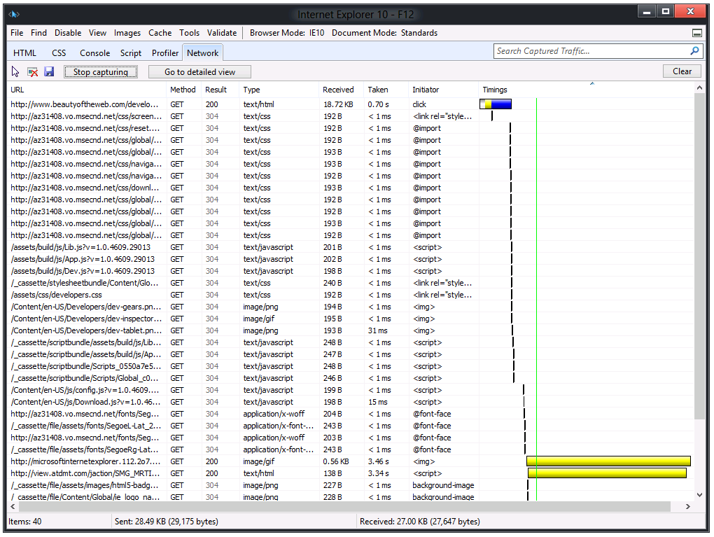
Overview of the F12 Developer Tools in Internet Explorer 10
The Navigation Timing API enables an application to determine the download speed for a web page:
window.performance.navigation
window.performance.timing
The F12 Developer Tools provide debugging and profiling capabilities in Internet Explorer
Notes:
This topic provides a brief overview of the F12 Developer Tools. Students have had an introduction to some of these tools in modules 1 and 2, but this topic and the following two demonstrations give you an opportunity to delve more deeply into the debugging and network profiling aspects.
20480B
8: Creating Interactive Pages by Using HTML5 APIs

Slide 27
Demonstration: Using the F12 Developer Tools to Debug JavaScript Code
In this demonstration, you will see how to use the F12 Developer Tools to:
Set a breakpoint in JavaScript code
Step through JavaScript code and examine variables
Notes:
While running the debugger, be prepared to discuss the Console, Watch, and Call stack tabs in the right pane. They operate in a similar manner to the corresponding features in Visual Studio. The debug tools in the F12 Developer Tools toolbar are also very similar to the debug tools in Visual Studio.
Note: You cannot use the F12 Developer Tools to debug JavaScript code for a web application that is already running by using the Visual Studio debugger.
Preparation Steps
Start the MSL-TMG1 virtual machine if it is not already running.
Start the 20480B-SEA-DEV11 virtual machine if it is not already running, and log in as Student with the password Pa$$w0rd.
Demonstration Steps
Set a Breakpoint in JavaScript code
On the Windows 8 Start screen, click the Desktop tile.
On the Windows taskbar, click Internet Explorer.
In Internet Explorer, browse to the file E:\Mod08\Democode\Document.html.
If the message Internet Explorer restricted this webpage from running scripts or ActiveX controls appears, click Allow blocked content.
Press F12 to display the Developer Tools window.
If the F12 Developer Tools window appears as a pane in Internet Explorer, in the F12 Developer Tools pane, click Unpin.
Note: This action causes the F12 Developer Tools to appear in a standalone window.
In the F12 Developer Tools window, click Script.
Click in the margin next to line 12, in order to create a breakpoint on the first statement inside the onload() function.
20480B
8: Creating Interactive Pages by Using HTML5 APIs
(More notes on the next slide)

Slide 28
Text Continuation Slide
Notes:
Step Through JavaScript Code and Examine Variables
On the F12 Developer Tools toolbar, click Start debugging.
In the F12 Developer Tools window, verify that the debugger pauses execution at the breakpoint.
In the right pane, click the Locals tab.
On the F12 Developer Tools toolbar, click the Step over button several times to step through the code. In the Locals tab, verify that the value of the i variable changes as execution progresses.
Close the F12 Developer Tools window.
Close Internet Explorer.
20480B
8: Creating Interactive Pages by Using HTML5 APIs

Slide 29
Demonstration: Using the F12 Developer Tools to Profile a Web Application
In this demonstration, you will see how to use the F12 Developer Tools to:
Examine the network traffic for a web application
Capture profile data for a web application
Notes:
In the detailed view of the network traffic, be prepared to briefly describe each of the items, especially the headers, body, cookies, and timings. Also mention that the network capture can be saved as an XML file.
Also, in the profiler data, point out the values in the Count, Inclusive time (ms), Inclusive Time %, and Exclusive time(ms) columns.
Preparation Steps
Start the MSL-TMG1 virtual machine if it is not already running.
Start the 20480B-SEA-DEV11 virtual machine if it is not already running, and log in as Student with the password Pa$$w0rd.
Demonstration Steps
Examine the Network Traffic for a Web Application
On the Windows 8 Start screen, click the Desktop tile.
On the Windows taskbar, click Internet Explorer.
In Internet Explorer, browse to the website http://www.beautyoftheweb.com/.
Press F12 to display F12 Developer Tools window.
In the F12 Developer Tools window, click Network.
On the F12 Developer Tools toolbar, click Start capturing.
In Internet Explorer, click the touchgallery icon in the navigation bar.
Return to the F12 Developer Tools window.
Click the first line of the network capture, and then on the toolbar click Go to detailed view.
Click each of the following tabs and show the data that they contain:
Request headers.
20480B
8: Creating Interactive Pages by Using HTML5 APIs
(More notes on the next slide)

Slide 30
Text Continuation Slide
Notes:
Request body.
Response headers.
Response body.
Cookies.
Initiator.
Timings.
11. On the F12 Developer Tools toolbar, click Stop capturing.
Capture Profile Data for a Web Application
In the F12 Developer Tools window, click Profiler.
On the F12 Developer Tools toolbar, click Start profiling.
In Internet Explorer, click the videos icon in the navigation bar.
Return to the F12 Developer Tools window.
On the F12 Developer Tools toolbar, click Stop profiling.
On the F12 Developer Tools toolbar, in the Current view list, click Call tree.
In the Search Profiler box, type onWindowEvent and then press ENTER.
In the captured data, examine the work performed by the onWindowEvent event handler.
Double-click onWindowEvent to display the code for this event handler in the Script window
Press Ctrl+ Alt+ O to display the tools menu, and then select Format JavaScript to display the code in an easier to read format.
Close the F12 Developer Tools window.
Close Internet Explorer.
(More notes on the next slide)
20480B
8: Creating Interactive Pages by Using HTML5 APIs

Slide 31
Demonstration: Creating Interactive Pages with HTML5 APIs
In this demonstration, you will learn about the tasks that you will perform in the lab for this module.
Notes:
Read the Lab Scenario to students and point out that they should read each scenario before attempting the lab for a module.
Point out to students that the Exercise Scenario for each exercise contains a description of what they will accomplish in the exercise, and is also essential reading.
Start Visual Studio, and open the ContosoConf.sln solution in the E:\Mod08\Labfiles\Solution\Exercise 3 folder.
In Solution Explorer, expand the ContosoConf project, and then double-click speaker-badge.htm.
In the Code Editor window, scroll through the code and find the following <section> element:
<section class="page-section badge">
<div class="container">
<h1>Create your speaker badge for ContosoConf</h1>
<p>Drag and drop your profile picture here...</p>
<img style="width: 300px; height: 300px; border: 1px solid #000"/>
</div>
</section>
Explain that the students will add drag and drop functionality to the <img> element in this section to enable a user to drag an image file and drop it on the web page, where it will appear in this element.
In Solution Explorer, expand the scripts folder, expand the pages folder, and then double-click speaker-badge.js. Students will complete the code for the SpeakerBadgePage object in this script to handle dragover and dragdrop events. When the dragdrop event occurs, the event handler will read the file dropped on the image element and display the contents on the web page.
Display the speaker-badge.htm file in the Code Editor window, and then on the Debug menu, click Start Without Debugging.
20480B
8: Creating Interactive Pages by Using HTML5 APIs
(More notes on the next slide)

Slide 32
Text Continuation Slide
Notes:
Note: It is necessary to display this file in the Code Editor window so that Visual Studio navigates directly to this page when it starts the application; the Speaker Badge page is not listed in the navigation bar.
Note: If the message Intranet settings are turned off by default appears, click Don’t show this message again.
On the Windows taskbar, click File Explorer and browse to E:\Mod08\Labfiles\Resources.
Drag-and-drop mark-hanson.jpg from File Explorer, onto the empty rectangle in Internet Explorer, and verify that the image appears on the page
Close Internet Explorer.
In Solution Explorer, double-click index.htm.
Find the following section near the bottom of the file. This section contains the HTML markup for the video controls that download and play a video presentation of a session from a previous conference:
<section class="video">
<h2>Video from last year</h2>
<video src="http://ak.channel9.msdn.com/ch9/265b/9a76fccd-941e-4285-ad00-9ea200aa265b/MIX09KEY01_high_ch9.mp4"></video>
<div class="video-controls" style="display: none">
<button class="video-play">Play</button>
<button class="video-pause">Pause</button>
<span class="video-time"></span>
</div>
</section>
In Solution Explorer, in the scripts\pages folder, double-click video.js. Explain that this file contains
the code that students will write to play and pause the video, and display the elapsed time while the
(More notes on the next slide)
20480B
8: Creating Interactive Pages by Using HTML5 APIs

Slide 33
Text Continuation Slide
Notes:
video runs.
On the Debug menu, click Start Without Debugging.
Scroll to the bottom of the Home page and click Play. Notice that the video starts running, a Pause button appears, and the elapsed time is also displayed.
Click Pause to suspend the video.
Close Internet Explorer.
In Solution Explorer, double-click location.htm.
Find the following section near the bottom of the file. This <h2> element with the id of distance will be used to display the distance of the user from the conference location:
<section class="travel">
<h1>Travelling to ContosoConf</h1>
<h2 id="distance"></h2>
<h2>Address</h2>
<address>
...
</address>
<h2>Hotels</h2>
<p>...</p>
</section>
In Solution Explorer, in the scripts\pages folder, double-click location.js. Explain that this file contains the code that students will complete to find and display the distance of the user from the conference location by using the Geolocation API.
On the Debug menu, click Start Without Debugging.
(More notes on the next slide)
20480B
8: Creating Interactive Pages by Using HTML5 APIs

Slide 34
Text Continuation Slide
Notes:
In the navigation bar, click Location.
In the message box localhost wants to track your physical location, click Allow once.
In the Enable Location Services dialog box, click Yes.
Point out that the distance to the conference venue appears above the address on the Location page.
Close Internet Explorer.
Preparation Steps
Start the MSL-TMG1 virtual machine if it is not already running.
Start the 20480B-SEA-DEV11 virtual machine if it is not already running, and log on as Student with the password Pa$$w0rd.
(More notes on the next slide)
20480B
8: Creating Interactive Pages by Using HTML5 APIs

Slide 35
Lab: Creating Interactive Pages with HTML5 APIs
Exercise 1: Dragging and Dropping Images Exercise 2: Incorporating Video Exercise 3: Using the Geolocation API to Report the User's Current Location
Logon Information
Virtual Machines: 20480-SEA-DEV11, MSL-TMG1
User Name: Student
Password: Pa$$w0rd
Estimated Time: 60 minutes
Notes:
Exercise 1: Dragging and Dropping Images
In this exercise, you will begin working on the Speaker Badge page. This page will eventually enable conference speakers to create a badge displaying their name, photo, and ID barcode. In this exercise, you will implement drag-and-drop support so that an image of a speaker can be dropped onto the web page and displayed.
You will add event listeners to handle drag-and-drop events. Then you will use the File API’s FileReader object to read a file as a data URL, which is then displayed on the page. Finally, you will run the application and test the Speaker Badge page.
Instructor Note: Students should use the project in the E:\Mod08\Labfiles\Starter\Exercise 1 folder for this exercise.
Mention to students that a working solution for this exercise is available in the E:\Mod08\Labfiles\Solution\Exercise 1 folder.
Exercise 2: Incorporating Video
In this exercise, you will add a video to the website Home page. You will add custom controls that enable a user to play and pause the video, and then you will handle video events to display how much playback time has elapsed. Finally, you will run the application, view the Home page, and verify that it plays the video correctly.
Instructor Note: Mention to students that a working solution for this exercise is available in the E:\Mod08\Labfiles\Solution\Exercise 2 folder.
Exercise 3: Using the Geolocation API to Report the User's Current Location
In this exercise, you will modify the Location page to react to the current geographic location of the user viewing the page.
You will use the Geolocation API to get the visitor’s current location, and then you will calculate and display the distance to the conference venue. Finally, you will run the application and verify that this feature is working as expected.
Instructor Note: Students should use the project in the E:\Mod08\Labfiles\Starter\Exercise 3 folder for
20480B
8: Creating Interactive Pages by Using HTML5 APIs
(More notes on the next slide)

Slide 36
Text Continuation Slide
Notes:
this exercise.
Mention to students that a working solution for this exercise is available in the E:\Mod08\Labfiles\Solution\Exercise 3 folder.
20480B
8: Creating Interactive Pages by Using HTML5 APIs

Slide 37
Lab Scenario
The ContosoConf organizers want to highlight the latest HTML5 technologies in order to create an interactive experience for people visiting the conference website. Specifically, the conference organizers have asked you to add the following features to the application:
Conference speakers need a way to generate their badges. A web page should be added that enables a speaker to drag-and-drop a profile picture to start creating their badge.
A video from a previous conference is available. This video should be available on the Home page.
The Location page should be customized to display information about the visitor’s current physical location.
Notes:
20480B
8: Creating Interactive Pages by Using HTML5 APIs

Slide 38
Module Review and Takeaways
Review Question(s)
Notes:
Review Question(s)
Question
What methods are provided by the FileReader interface for reading files on the local file system?
Answer
readAsText(), readAsDataURL(), and readAsArrayBuffer().
Question
HTML5 browsers are guaranteed to support the .mp4 video format. True or false?
( )False
( )True
Answer
(√)False
( )True
Question
What methods are provided by the navigator.geolocation object for obtaining geolocation information?
Answer
getCurrentPosition() and watchPosition().
Question
The F12 Developer Tools require that you have Visual Studio installed on your computer before you can use them to debug JavaScript code. True or False?
( )False
( )True
20480B
8: Creating Interactive Pages by Using HTML5 APIs
(More notes on the next slide)

Slide 39
Text Continuation Slide
Notes:
Answer
(√)False
( )True
20480B
8: Creating Interactive Pages by Using HTML5 APIs

